Slide 1



UNIT 1
LESSON 4
HARD TO BELIEVE
Part 1

Slide 2
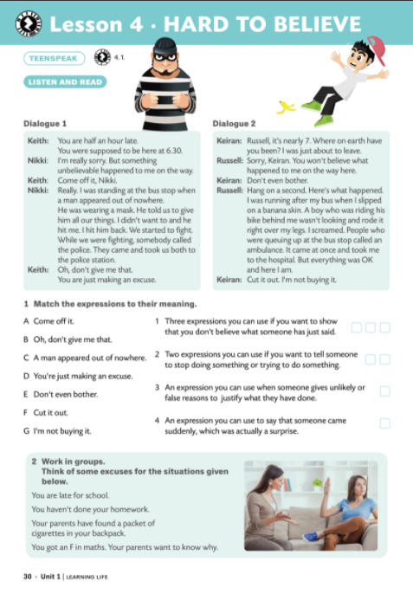
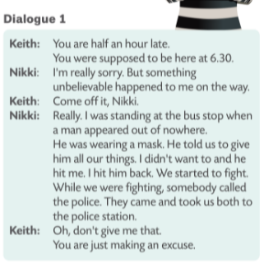
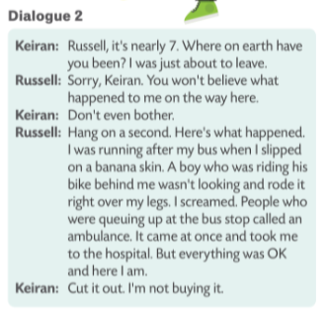

bus stop, man, mask, fight, police
bus, banana skin, bike, ambulance

Slide 3
Listen to the dialogue again.
Pay attention to Russell and Nikki’s excuses. What happened? Do Keith and Keiran believe them?

Slide 4
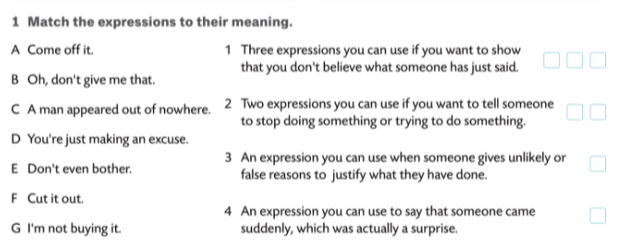
A
B
G
E
F
D
C

Slide 5
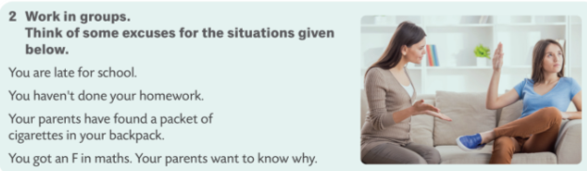
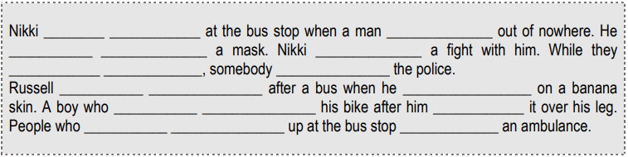
was waiting
appeared
was wearing
had
were fighting
called
was running
slipped
was riding
rode
were queuing
called

Slide 6
1 Who / wait / bus station / when / a man / appear out of nowhere?
2 What / he / wear?
3 What / Nikki / have with him?
4 Who / somebody / call / while / they/ fight?
1 Who was waiting at the bus stop when a man appeared out of nowhere?
2 What was he wearing?
3 What did Nikki have with him?
4 Who did somebody call while they were fighting?

Slide 7
